Slide 1


Revision

Slide 2
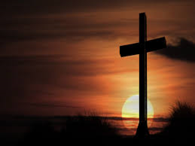
Christianity Beliefs and Teachings

Slide 3
Belief in one God
Christians believe there is one God. This belief is called …………………………………
Ancient religions from Rome and Greece believed there were lots of gods. This belief is called ………………………………

Slide 4
Belief in one God
Christians believe there is one God. This belief is called monotheism
Ancient religions from Rome and Greece believed there were lots of gods. This belief is called polytheism

Slide 5
Denominations
Name 3 different Christian denominations
Do you know how they are different?

Slide 6
Roman Catholic
Authority of the Pope
Orthodox
Emphasises the mystery of God
Anglicans - ‘The Church of England’
Led by the Archbishop of Canterbury
Protestants – Baptists, Methodists and others
Emphasise the authority of the Bible

Slide 7
Qualities of God
Name 4 ‘qualities’ of God
Are you using key vocabulary and definitions?
Can you give another suggestion of an attribute that Christians believe God has?

Slide 8
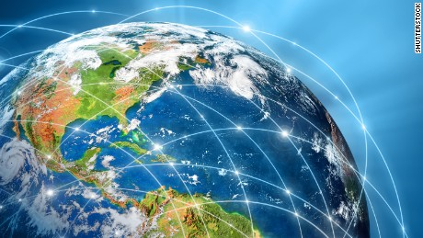
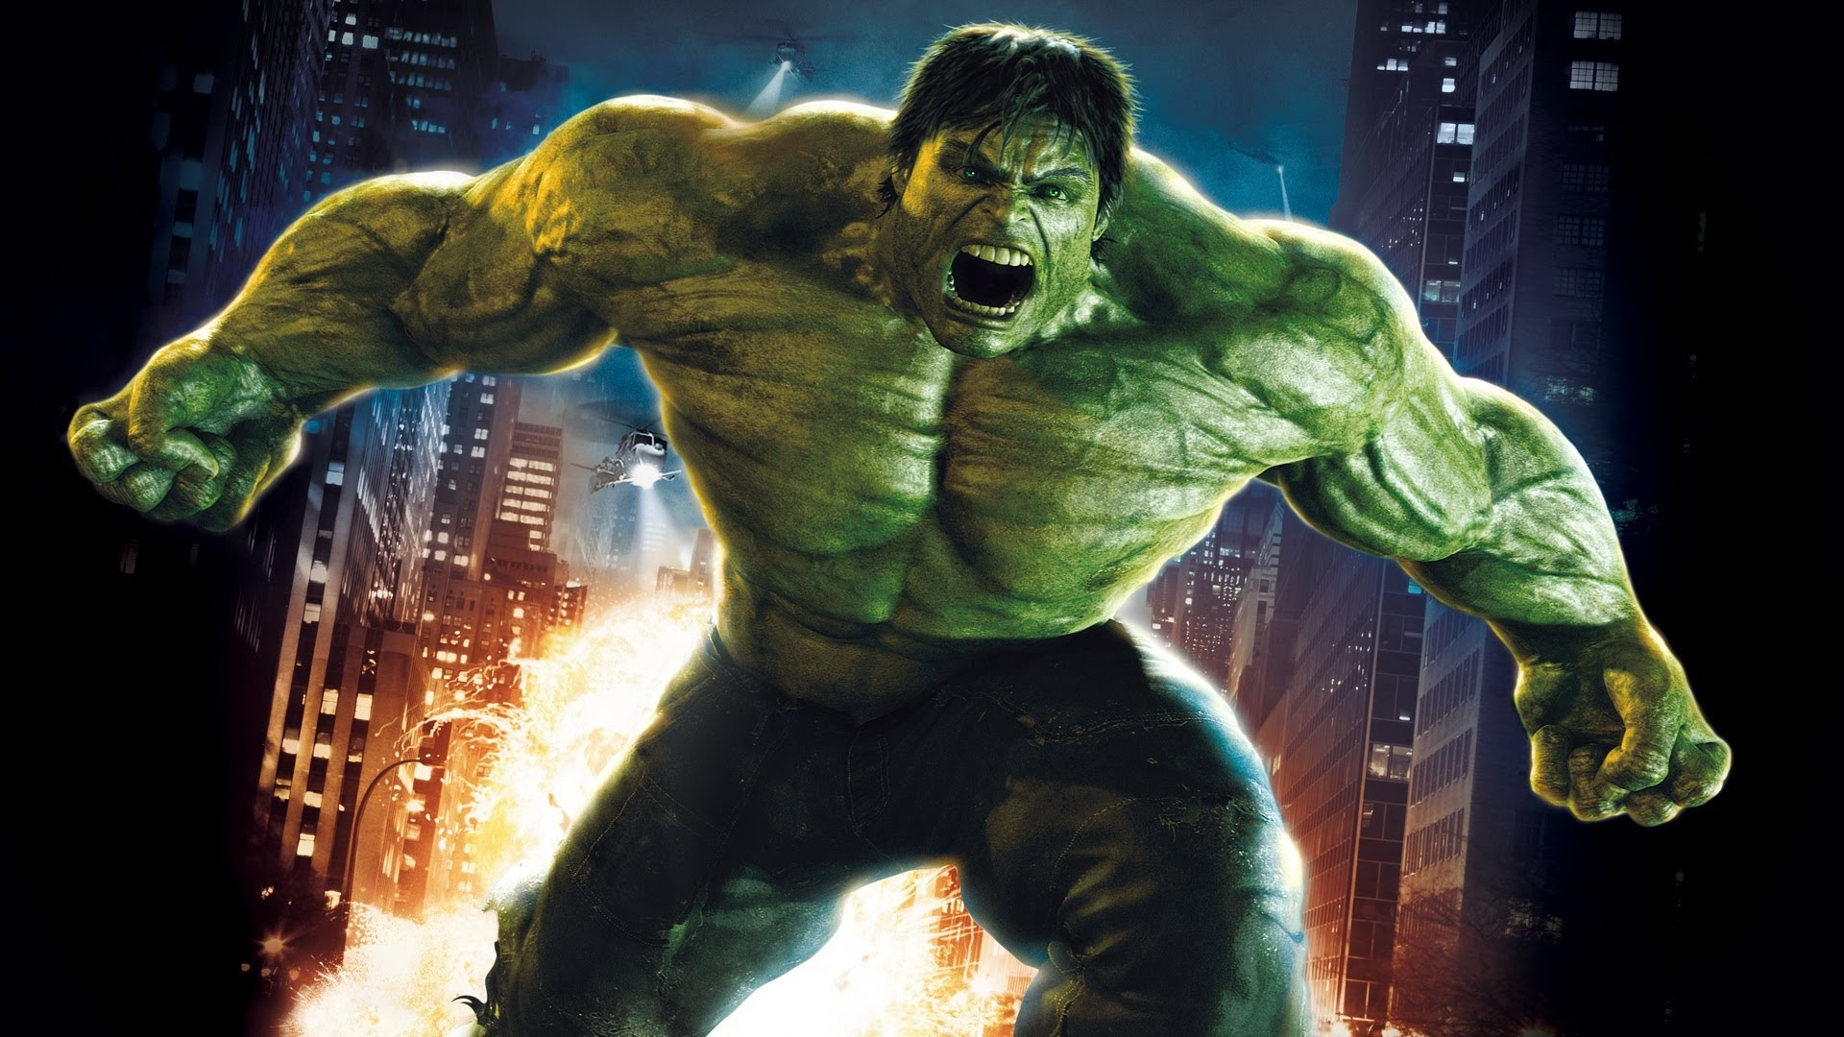


QUALITIES OF GOD
Omnipresent = EVERYWHERE
Omnipotent = ALL POWERFUL
Omniscient = ALL KNOWING
(Omni)Benevolent = LOVING

Slide 9
Qualities of God
Name 4 ‘qualities’ of God
Omnipresent – everywhere
Omnipotent – all powerful
Omniscient – all knowing
Omnibenevolent – all loving
Another attribute that Christians believe God has is that he is a just God – perfect giver of justice

Slide 10
Trinity
What does the term ‘trinity’ mean?
Can you name all the ‘parts’?

Slide 11
Trinity
What does the term ‘trinity’ mean?
The belief that the one God is made up of three personalities / aspects / persons
Can you name all the ‘parts’?
Father – creator of the universe
Son – human on earth, Jesus
Holy Spirit – within Christians, guiding and sustaining

Slide 12
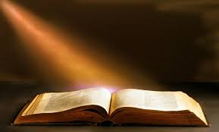
Sacred Writing
What does it mean when a question asks you to link to sacred writing or another source of religious belief and teaching?

Slide 13
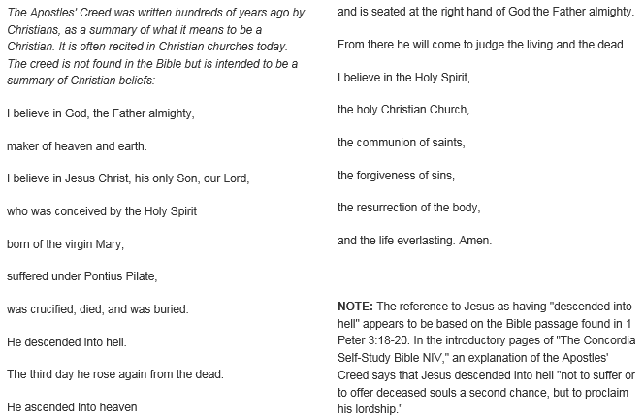

Slide 14
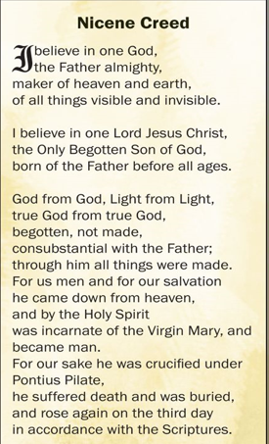

Slide 15
Creation
What is the Christian Creation Story?
Can you make a reference to scripture?

Slide 16
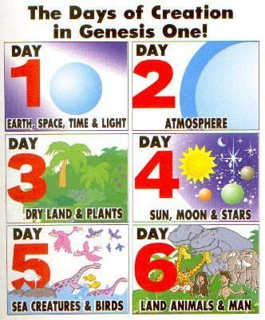
Reference:
The Bible
At the beginning
Genesis
Chapter 1
Genesis 1

Slide 17
Jesus
Birth
Life
Death
Christian understanding and impact

Slide 18
Birth of Jesus
People question the virgin conception
Accuracy of the story is not that important as long as we understand Jesus to be the Son of God

Slide 19
Christian beliefs about Jesus
Christians believe that Jesus is God in human form. He is often called ‘the Incarnation’
As the Son of God, Jesus shows people what God is like
He is also the perfect example of a human being
They believe that Jesus is one third of the Trinity - He is the part of the Trinity they refer to as ‘Son’

Slide 20
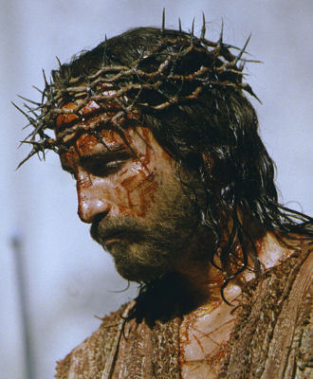
Death of Jesus
What do you know about the death of Jesus?

Slide 21
Crucifixion
Form of execution favoured by the Romans - Public
This is how Jesus died
Impact for Christians today?
Suffering is a part of life – experienced by Jesus
God understands what the sufferer is going through

Slide 22
Resurrection
Rising from the dead - Jesus rose from the dead (recorded in all four gospels)
Impact for Christians today?
Significant evidence of the divine nature of Jesus
Resurrection shows the power of good over evil
No need to fear death as will be resurrected
Without resurrection there would be no Christian faith

Slide 23
Ascension
Jesus returned to God, the Father, in heaven
Impact for Christians today?
Shows that Jesus is with God
Paves the way for the Holy Spirit to provide comfort and guidance

Slide 24
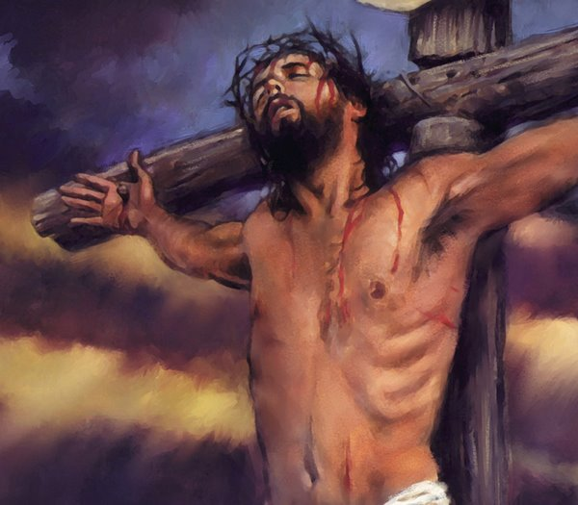
Death of Jesus
Why is the death of Jesus important for Christians?

Slide 25
Sin and Salvation
What do these terms mean?
What is the ‘original sin’?

Slide 26
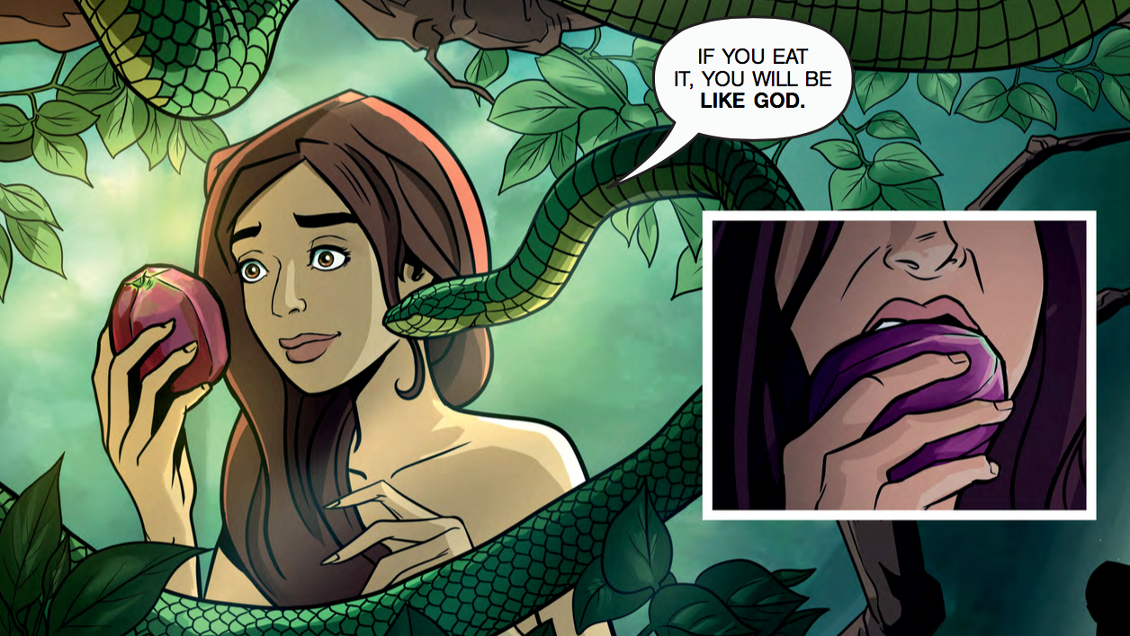
Original sin = Adam and Eve defying God and eating from the tree of knowledge of good and evil.

Slide 27
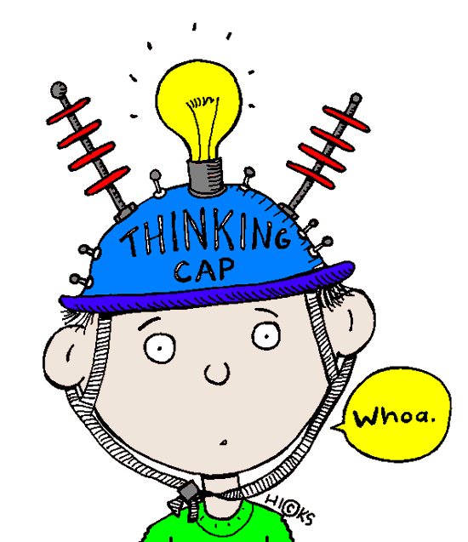
Salvation = Being saved from sin and the consequences of it.
Being granted eternal life with God.
How might this be achieved by Christians?
Through good works / obeying God’s law
Grace – given by God; a gift for the faithful

Slide 28
‘For God so loved the world that He gave His one and only Son, that whoever believes in Him shall not perish but have eternal life.’
JOHN 3:16

Slide 29
Jesus as Redeemer – Jesus is punished for the sins of all humans
By receiving the punishment on their behalf, he ‘buys back’ the relationship between God and humans
Only Jesus can do this because he is God and man
Jesus’ death is an act of love and by rising from the dead he brings new hope to the world

Slide 30
What happens when we die?
What do Christians believe about life after death?
Can you suggest how this might impact them in their daily lives?

Slide 31
Use page 24 in the Christianity text book to help you complete each section
The Afterlife
Heaven
Judgement
Hell

Slide 32

‘The afterlife is a good way to get people to behave themselves and help others.’
Evaluate this statement

Slide 33
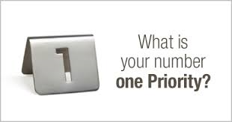
Revision

Slide 34
What can I do now?
Make revision cards with key terms or points on
Go through your existing notes and write a summary box at the bottom of each page with the key learning points
Log onto GCSE Bitesize and complete activities
Make mind maps for different aspects of the topics
Complete practice questions – Ask Mrs Jolley to mark
Write your own practice questions – swap with a partner to complete, then mark each others work

Slide 35
Practice Questions

Slide 36
2 Marks
Name two characteristics of God.
Name two persons of the Trinity.
Give two reasons why Jesus had to die.
Name two types of salvation.
State two things Christians believe about salvation.

Slide 37
4 Marks
Explain two ways in which belief in the resurrection of Jesus influences Christians today.
Explain two ways in which beliefs about the creation of the world might influence Christians today.
Explain two ways in which learning about the crucifixion might influence Christians today.

Slide 38
4 Marks
Explain two ways in which believing that God is all-loving might influence Christians today.
Explain two ways in which believing in Judgement Day might influence Christians today.
Explain two ways in which believing that God is just influences Christians today.

Slide 39
5 Marks
Explain two Christian teachings about judgement. Refer to sacred writing or another source of religious belief and teaching in your answer.
Explain two Christian teachings about the creation. Refer to sacred writing or another source of religious belief and teaching in your answer.

Slide 40
5 Marks
Explain two Christian teachings about God. Refer to sacred writing or another source of religious belief and teaching in your answer.
Explain two Christian teachings about salvation. Refer to sacred writing or another source of religious belief and teaching in your answer.

Slide 41
12 Marks
1. For a Christian, believing that God is all-powerful is not important.
Evaluate this statement. You should:
refer to Christian teaching
give developed arguments to support this statement
give developed arguments to support a different point of view
reach a justified conclusion

Slide 42
12 Marks
2. Christians should focus on living life here and now rather than focusing on an afterlife.
Evaluate this statement. You should:
refer to Christian teaching
give developed arguments to support this statement
give developed arguments to support a different point of view
reach a justified conclusion

Slide 43
12 Marks
3. It is more important to follow Jesus’ example than to spend time in worship.
Evaluate this statement. You should:
refer to Christian teaching
give developed arguments to support this statement
give developed arguments to support a different point of view
reach a justified conclusion

Slide 44
12 Marks
4. If God were loving there would be no suffering.
Evaluate this statement. You should:
refer to Christian teaching
give developed arguments to support this statement
give developed arguments to support a different point of view
reach a justified conclusion

Slide 45
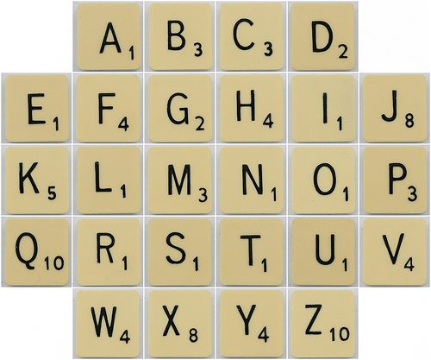
Just for fun:
Write out 10 key terms for this topic and see which one scores the highest

Slide 46


